Slide 1
Machine Learning Inference on Mobile Phones
Anuj Dutt
Bose Corporation

Slide 3
Changes in Mobile Phone SoC Market over Years
Most applications use CPU to perform hundreds of thousands of calculations per second. But some of the applications have become so CPU-Intensive that CPU alone was not enough.
Hence, SoC manufactures introduced GPU’s that could use multi-threading for doing multiple things in parallel and were the best at what they do rather than be average at doing everything.
As Machine Learning applications move towards the edge, more compute is required to run these applications in a power efficient way. CPU’s and GPU’s work for most applications, but now there is a new SoC in town: The specialized AI processors.

Slide 4
The need for AI Processors
These specialized AI processors are not only for providing more computational power but to increase efficiency in three main areas:
a) Size
b) Computation
c) Energy
Examples: Apple’s Bionic Neural Engine, Huawei HiSilicon Kirin 980 etc.
Specialized SDK’s: Google Neural Network API, Qualcomm Snapdragon Neural Processing Engine SDK etc.
Snapdragon 855 vs 845 vs Kirin 980 benchmarks: https://www.xda-developers.com/qualcomm-snapdragon-855-snapdragon-845-kirin-980-cpu-gpu-ai-benchmarks/
Image Source: https://www.androidauthority.com/smartphone-ai-processor-803019/

Slide 5
What does Machine Learning Inference on Mobile Phones Offer?

Slide 6
User Data Privacy
Keeping User data private is a hard job and a big onus lies upon the companies collecting the data.
We tend to talk about data privacy in the context of security breaches, but there are many instances when privacy violations involve people who have been granted access to data.
Regulators across the world are approach the data privacy concerns in different ways like the introduction of GDPR in EU, but is there something more that we can do?
Solution: Do as much processing as possible on the phone for ML applications. This way user’s data never has to leave their mobile phone.

Slide 7
No Extra Data Cost
With every app solution on a mobile device there is an internet data cost associated with it.
First data cost to download the application, specially spending extra data to download the application if it is pretty big in size.
Next, if your application is dependent on a Cloud API for the experience, there is the data cost to talk to those API’s.
For data intensive applications, the data will either have to be continually be streamed to the cloud or uploaded in big chunks, which again is an overhead cost.

Slide 8
No Server Maintenance Cost
Since the machine learning model is running locally within the application on the mobile device, you save a lot of money in terms of server maintenance for ML model hosting, storage costs for storing data, compute cost for ML inference in the cloud etc.

Slide 9
Always Available Applications
Doing all the processing on the mobile phone means that your application will work always irrespective of whether you have an internet connection or not.
Hence, the users never have to see any downtime or app unavailability.

Slide 10
Real Time Inference
Running the app with a machine learning model available locally helps the applications to do near-real time inference as there is no latency due to communication with the server in the cloud.

Slide 11
Mobile Machine Learning Recipe
ML Application = Efficient Pre-Trained Models + Efficient Mobile Inference Engine

Slide 12
Tools for Deploying ML Solutions on the Phone
Apple’s CoreML/CoreML 2 [iOS]
Google’s TFLite [Android/iOS]
Facebook’s Caffe2Go [Android/iOS]

Slide 13
Apple’s ML Ecosystem
2014 2016 2017 2018
Metal: low level and low overhead hardware accelerated 3D graphic and computer shader API.
BNNS: Basic Neural Network Subroutine ideal for Fully Connected Neural Networks
MPS: Metal Performance shaders, ideal for Convolution operations.
CoreML: Convert Pre-Trained or custom machine learning models in frameworks like TensorFlow, Keras, Scikit-Learn, PyTorch etc. to a format suitable for running in iOS applications.
CoreML 2: Convert and optimize models on the go for on-device application integration.

Slide 14
CoreML Architecture
Domain Specific Frameworks
ML Framework
ML Performance Primitives

Slide 15
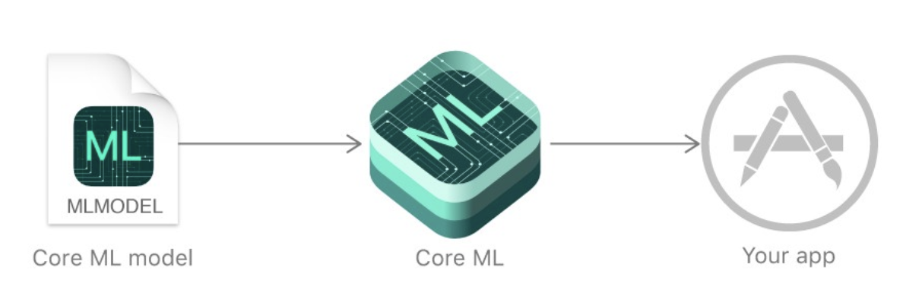
CoreML in Depth
CoreML supports Feed Forward NN, CNN’s, RNN’s, Tree Ensembles, SVM and Generalized linear Models.
The CoreML model contains a high level description of the machine learning model like the model weights, Input/Output types and structure of the network.
A CoreML model supports following input types:
Numerics, Categorical [Double, Int etc.]
Images as CVPixelBuffer
Arrays as MLMultiArray
Dictionaries
CoreML automatically takes care of hardware optimizations:
Compute heavy tasks are scheduled to run on the GPU or Neural Processing Engine.
Memory heavy tasks are scheduled to be run on Accelerate.
Auto-context switching from CPU to GPU and vice-versa for parts of the model.

Slide 16

CoreML Vision Framework
CoreML’s Vision framework is a specialized framework for applying computer vision algorithms to a variety of tasks involving image and video data.
Some of the examples include face and face landmark detection, text detection, barcode recognition, image registration, and general feature tracking.
Vision also allows the use of custom Core ML models for tasks like classification or object detection.

Slide 17
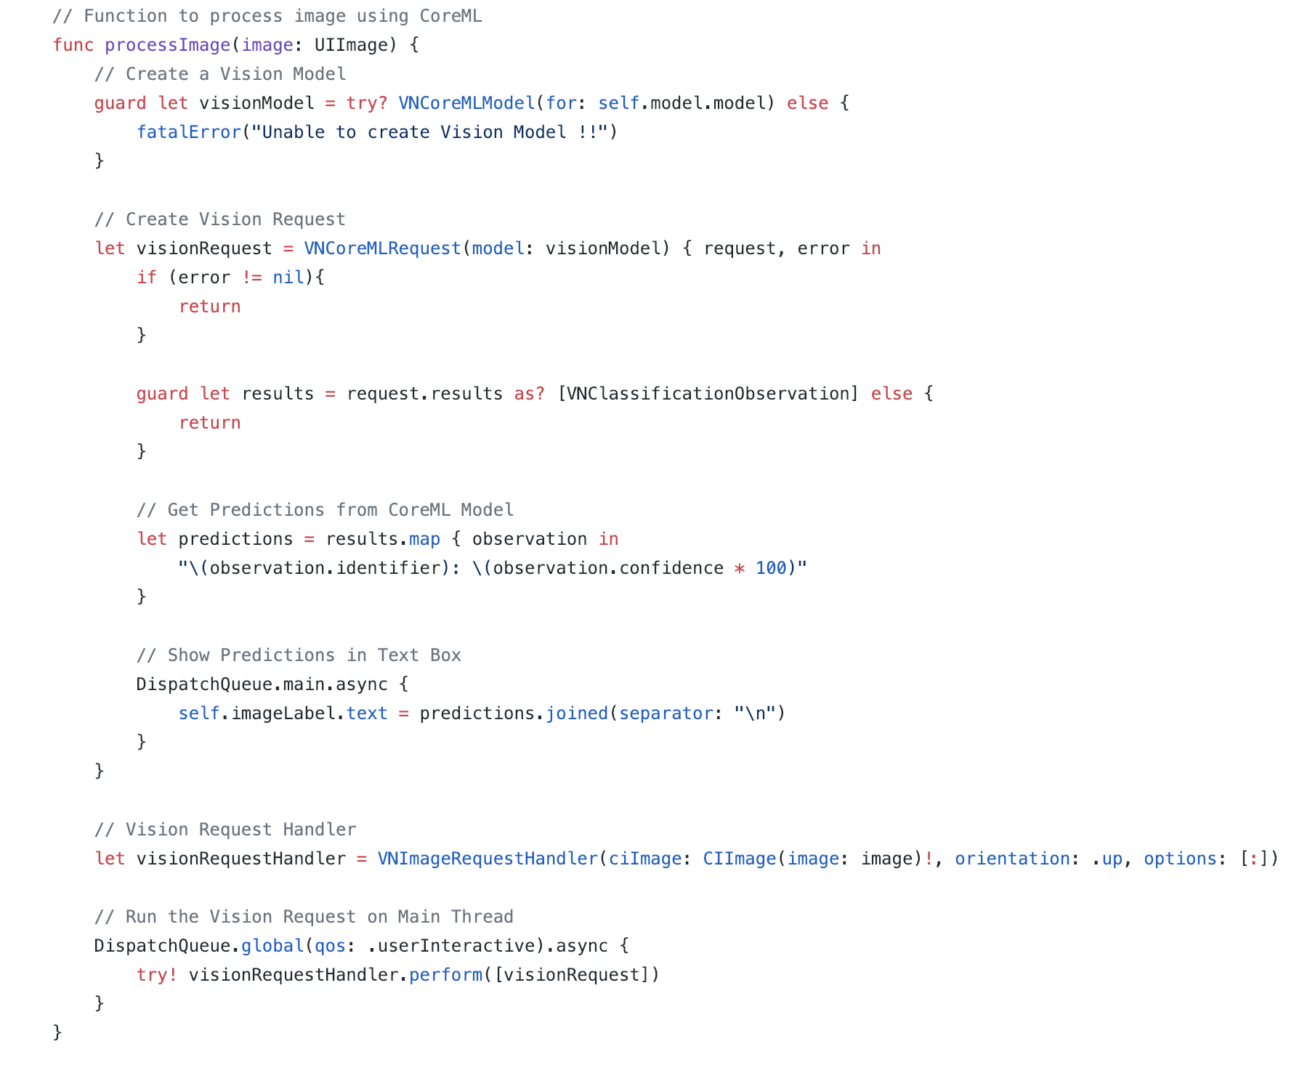
Using API’s from Vision Framework

Slide 18
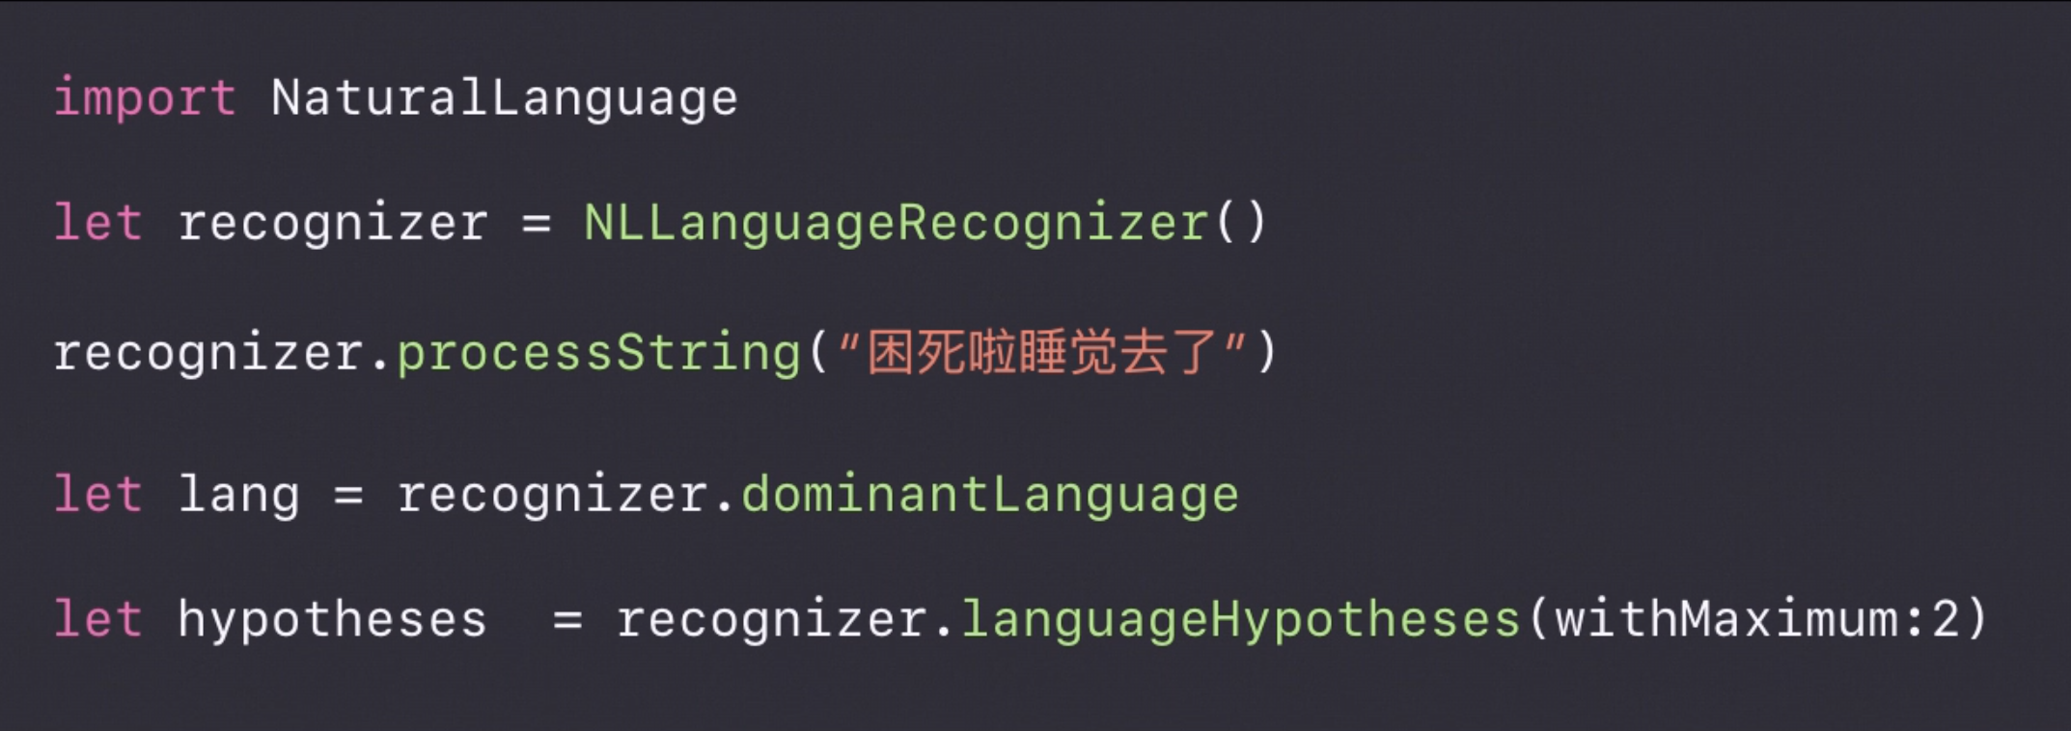
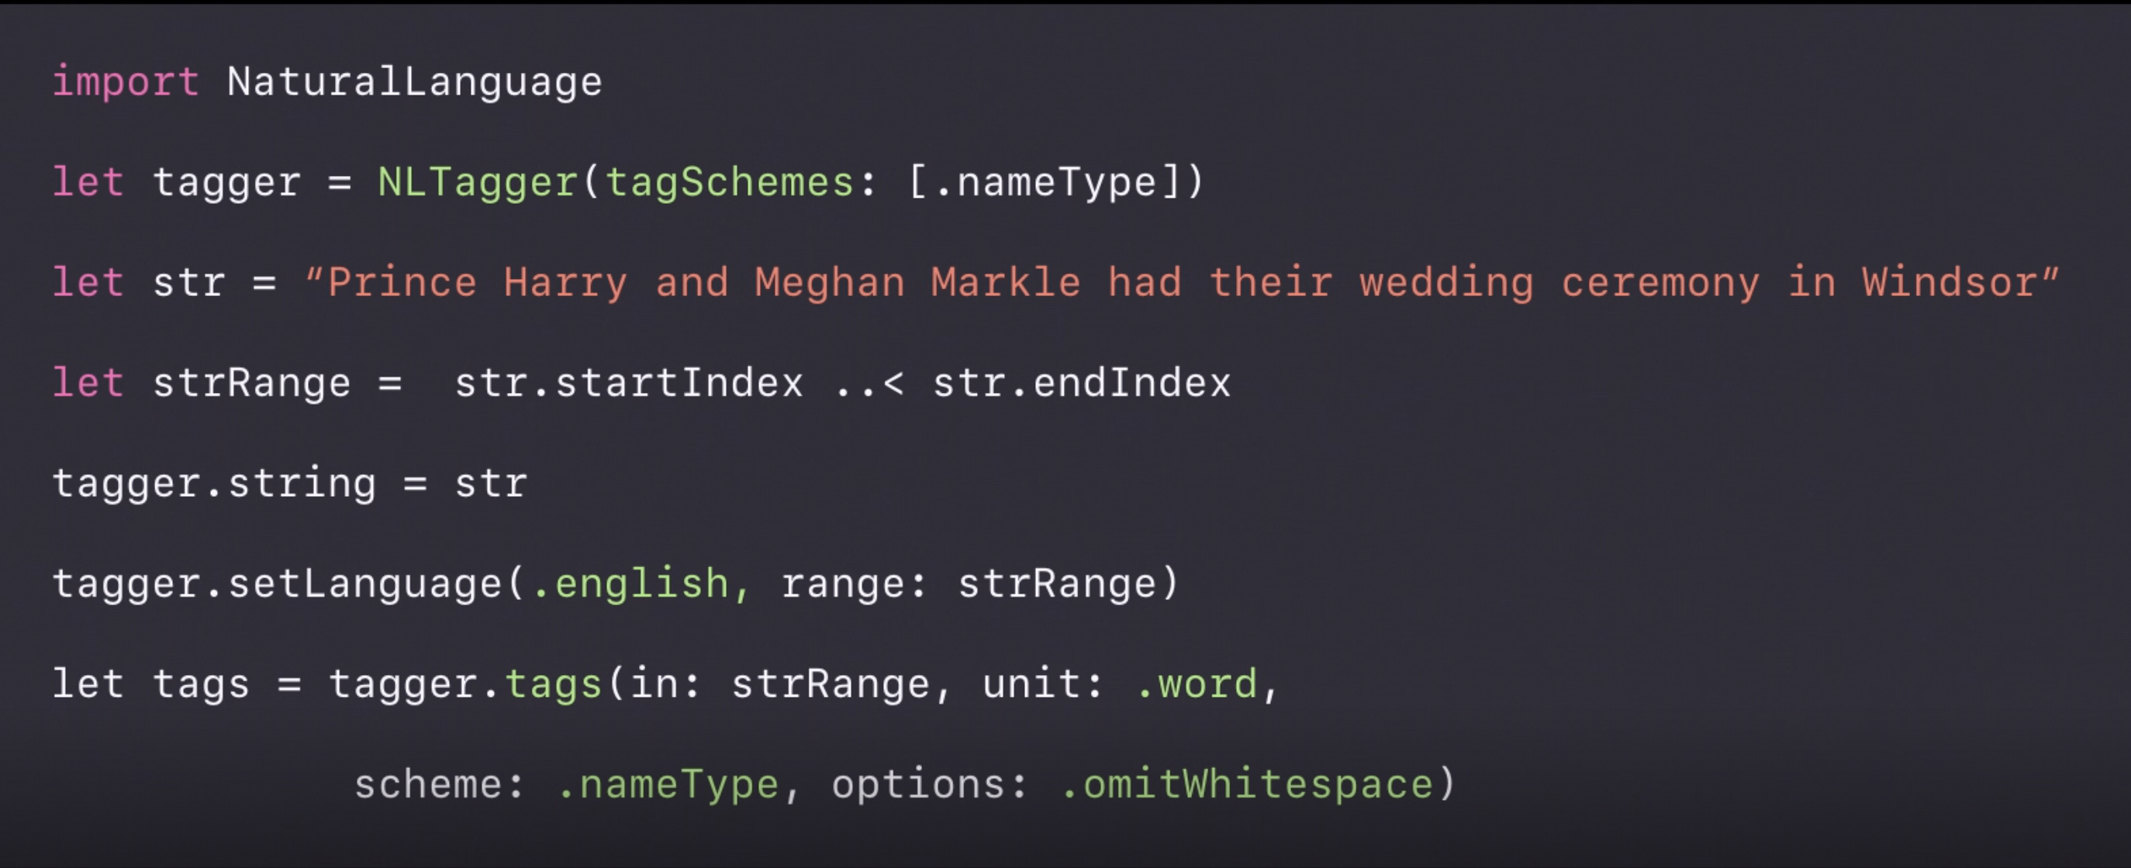
CoreML Natural Language Framework
Language Recognition
Word Tagging

Slide 19
CoreML Features
Reduced model size that ultimately reduces the overall app size using model weight quantization.
iOS 12 supports 8-bit, 4-bit unto 1-bit quantizations which reduces the model size drastically.
Note: Quantization might have an effect on your model accuracy. So, test for model accuracy after quantization and then decide if that decrease is acceptable for you or not, depending on your applications.
Batch Processing for processing data like images in batches instead of using a for loop, thereby reducing the overall processing time.
Flexible shapes specially for image and computer vision based applications. Instead of keeping the size of the inputs as constant, you can now pass a range for the input size.

Slide 20
CoreML 2: Weight Quantization

Slide 21
CoreML 2: Reduced Model Size

Slide 22
CoreML 2: Batch Processing

Slide 23
CoreML 2: Flexible Shapes

Slide 24
TFLite
If you have your model trained or saved in a .pb (Protobuf) format, then you can convert this model into a TFLite model using the pre-existing API’s in TensorFlow.
TFLite is a model file that contains the structure of the model as well as the weights and biases.
To run a TFLite model on Android, just deploy the model in an app and it’ll make use of Android’s ANN API to optimize the performance of the model.
For iOS, TFLite models use MPS to improve the performance of the model inference.

Slide 25
Saved ML Model to TFLite Format

Slide 26
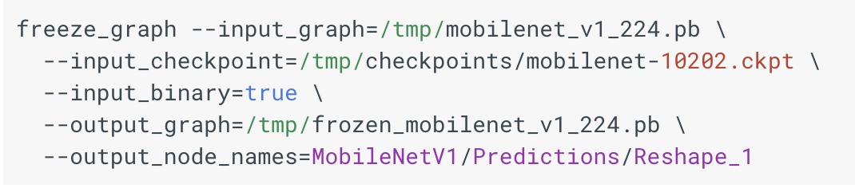
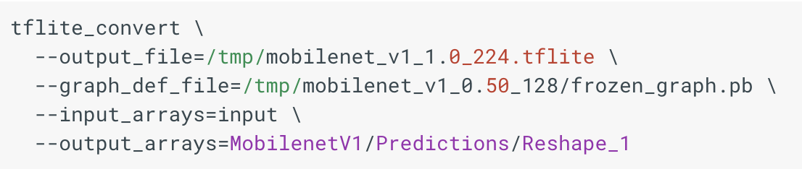
Using TFLite API
Freeze Graph using saved model [Protobuf + Checkpoint] :
Convert Frozen Graph to TFLite Model :

Slide 27
TFLite Features
TFLite models are small, faster and require minimal dependencies to run on an Android or an iOS device.
TFLite requires around 75 KB of memory for the core interpreter and around 400 KB when combined with the supported operations. This is way smaller as compared to TFMobile.
TFLite takes advantage of hardware acceleration for faster inference. It makes use of Flat buffers that reduces the code footprint, memory usage, CPU cycles required for serialization and deserialization thereby improving the app startup time.
TFLite’s Interpreter uses static memory and static execution plan thereby reducing the load time.

Slide 28
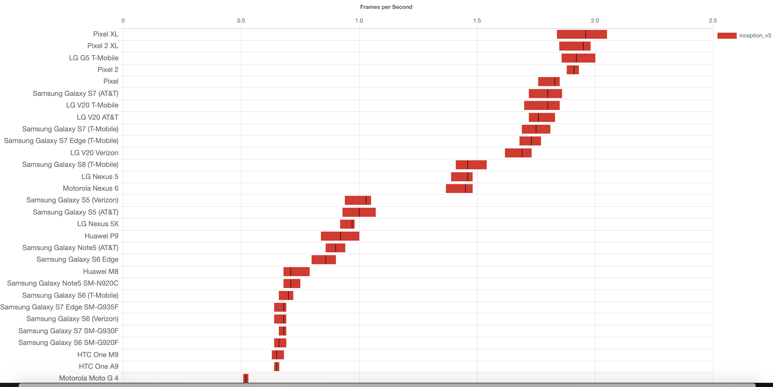
TFLite Benchmark for Inception V3

Slide 29
Caffe2
Caffe2: Deep Learning framework built by Facebook.
This framework is built for speed as it has built-in optimizations for different hardware architectures like:
For ARM based CPU, it makes use of NEON Kernels and NNpack which are acceleration packages for running neural networks on multi-core CPU.
For iOS devices, it makes use of MPSGraph and Metal libraries to speed up performance on the GPU.
For Android devices, it makes use of Qualcomm Snapdragon Neural Processing SDK that manages efficient running of machine learning models on CPU, GPU and DSP.
It also supports the models in ONNX format as that allows interoperability between Caffe2 and PyTorch as well as other frameworks like TensorFlow, Keras etc.

Slide 30
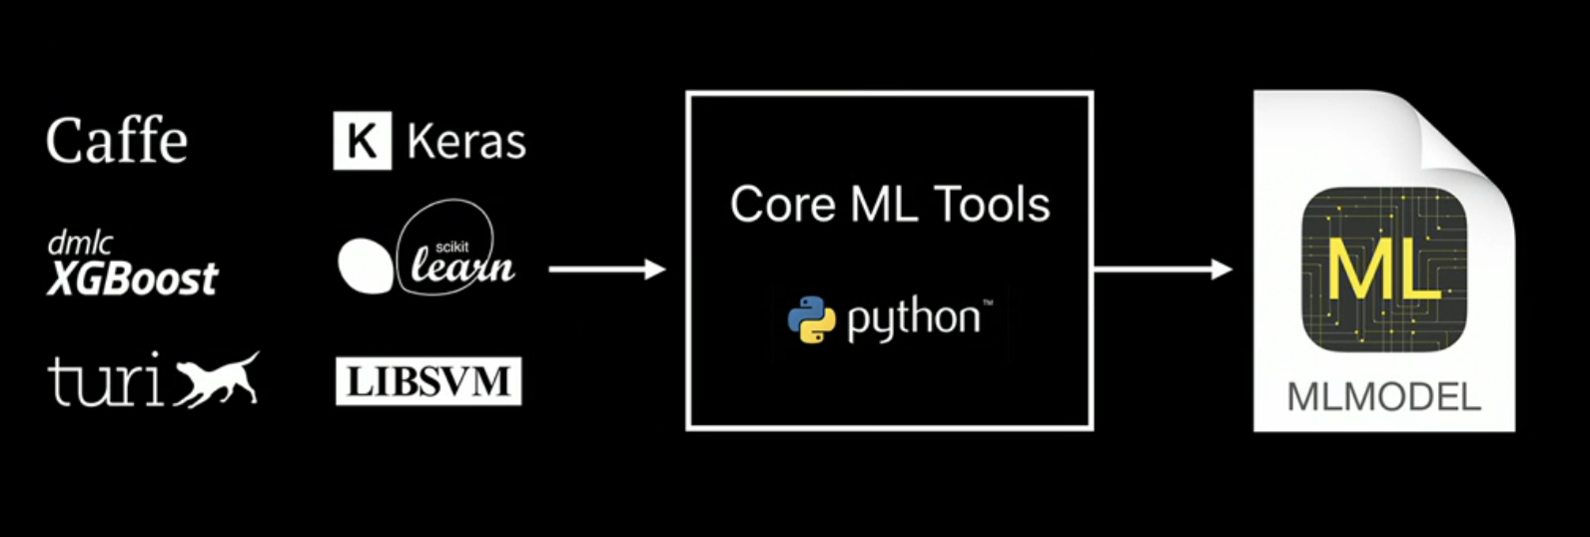
Tools to deploy ML Models on iOS
Microsoft Custom Vision API
Turi Create
CreateML
Coremltools
TF-CoreML
ONNX-CoreML
ML Kit
MMDNN

Slide 31
Tools to deploy a ML Model on Android
Microsoft Custom Vision API
TensorFlow TFLite Converter
ML Kit

Slide 32
Applications for ML on Mobile Phones
Apple’s Face ID for unlocking the phone, authentication etc.
Gmail and LinkedIn’s Smart Reply feature using LSTM on device.
Face Landmark detection for Facebook’s on-device Augmented Reality.
Google and Apple keyboard’s predictive text for messages, emails etc.
Activity Classification on Mobile Phones and Smart Watches.
Shazam for music discovery.
Image Segmentation with point clouds for Augmented Reality. ex. 6D.ai

Slide 33
Demo

Slide 34
Questions ??

